Slide 1
HNVec-Driven MultiDL Framework for Hindi News Classification

Slide 2
INTRODUCTION
This project aims to automate the categorization of Hindi news articles. Given a Hindi news article as input, the system will classify it into a predefined category. News articles have various categories such as accident, business, sports, entertainment and political.
Automating news categorization will save time and resources, making it easier to manage large volumes of news content efficiently.
In order to enhance the accuracy and effectiveness of proposed models, we will seek to create a novel algorithm.

Slide 3
OBJECTIVE
This project is designed with a strong emphasis on practical implementation, ensuring its applicability in real-world scenarios.
By addressing problem of manual classification of Hindi text, it provides an efficient and scalable solution that can be integrated into existing systems.
The methodologies and technologies we are going to use in this project will allow the improvement in terms of efficiency, accuracy and automation.

Slide 4
Methodology For HNVec Model
DATA-SET COLLECTION :
For multi-class classification, getting data from Disaster dataset from IIT Patna and BBC Hindi News Dataset from GitHub and Kaggle.
DATA CLEANING :
The dataset was cleaned by combining multi-row articles into single rows, deleting blank lines, removing unnecessary and empty ad lines.
DATA PREPARATION :
Used preprocessing techniques like tokenization, embedding, stopword removal, text cleaning, and vectorization.

Slide 5
Methodology For HNVec Model
VOCABULARY MAPPING :
Calculating number times a word occur and mapping word to their id’s (providing unique id to each word).
CO-OCCURANCE MATRIX :
Using distance based weighting to create matrix, giving more weight to closest word.
HNVec MODEL :
Global Vectors for Word Representation (HNVec) model is a machine learning algorithm that represents words as vectors.

Slide 6
Implementation of HNVec
DATA PROCESSING :
Includes gathering, cleaning, tokenization of data
INITIALIZING HNVec MODEL PARAMETERS :
Includes setting the dimension of embeddings, two weight matrices, epochs, learning rates and x max.
TRAINING MODEL :
Training HNVec model using Stochastic Gradient Descent (SGD) that optimizes models by minimizing errors.
Saving the embeddings in txt format and the model in pkl format.

Slide 7
About HLM-CLS
HLM-CLS demonstrates a novel hybrid architecture that integrates CNN, LR and SVM to improve text classification performance.
CNN is used for semantic feature generation, capturing hierarchical patterns and contextual information from text data.
The feature representations extracted by CNN are then passed to Logistic Regression and SVM, which are trained on this combined feature space to learn distinct decision boundaries and aid in dimensionality reduction.
LR and SVM each produce reduced feature sets that capture linear and margin-based insights respectively.
These reduced features are concatenated to form the final feature representation.
A final SVM classifier is trained on this enriched, reduced feature set to perform the ultimate classification task with improved generalization and robustness.

Slide 8
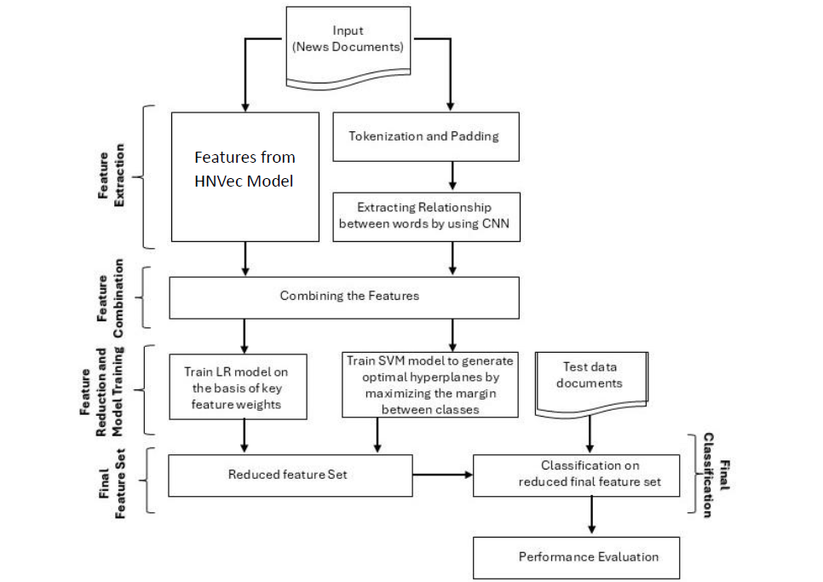
Integrating HNVec with HLM-CLS Pipeline
The flow diagram illustrates the integration of the HNVEC model with the HLM-CLS pipeline for Hindi news categorization.

Slide 9
Results
Model | Train:Test | Epoch | Training Accuracy | Testing Accuracy | Precision | Recall | F1 Score | Validation Loss | Training Loss
HNVec | 90:10 | 10 | 94.23 | 85.29 | 85.47 | 85.29 | 85.13 | 5.01 | 4.70
 |  | 20 | 94.17 | 85.29 | 85.47 | 85.29 | 85.13 | 5.01 | 4.97
 |  | 30 | 96.40 | 87.06 | 87.30 | 87.60 | 87.02 | 5.01 | 2.56
 |  | 40 | 96.53 | 85.88 | 86.49 | 85.88 | 85.90 | 4.69 | 2.41
 |  | 50 | 96.53 | 85.29 | 85.53 | 85.29 | 85.26 | 4.35 | 2.69
 | 80:20 | 10 | 98.01 | 87.65 | 88.32 | 87.65 | 86.79 | 6.43 | 2.05
 |  | 20 | 95.87 | 87.06 | 86.99 | 87.06 | 86.87 | 3.96 | 2.08
 |  | 30 | 94.40 | 86.47 | 86.27 | 86.47 | 86.28 | 5.01 | 4.98
 |  | 40 | 94.40 | 86.47 | 86.27 | 86.47 | 86.28 | 5.01 | 4.95
 |  | 50 | 94.47 | 86.76 | 86.54 | 86.76 | 86.54 | 5.01 | 4.94
 | 70:30 | 10 | 94.52 | 88.61 | 88.50 | 88.61 | 88.51 | 5.18 | 5.03
 |  | 20 | 94.36 | 88.61 | 88.50 | 88.61 | 88.51 | 5.01 | 4.97
 |  | 30 | 94.36 | 88.61 | 88.50 | 88.61 | 88.51 | 5.01 | 4.97
 |  | 40 | 94.36 | 88.61 | 88.50 | 88.61 | 88.51 | 5.01 | 4.99
 |  | 50 | 94.36 | 88.61 | 88.50 | 88.61 | 88.51 | 5.02 | 5.02
Table 1: Performance Metrics: HNVEC + HLM-CLS Pipeline

Slide 10
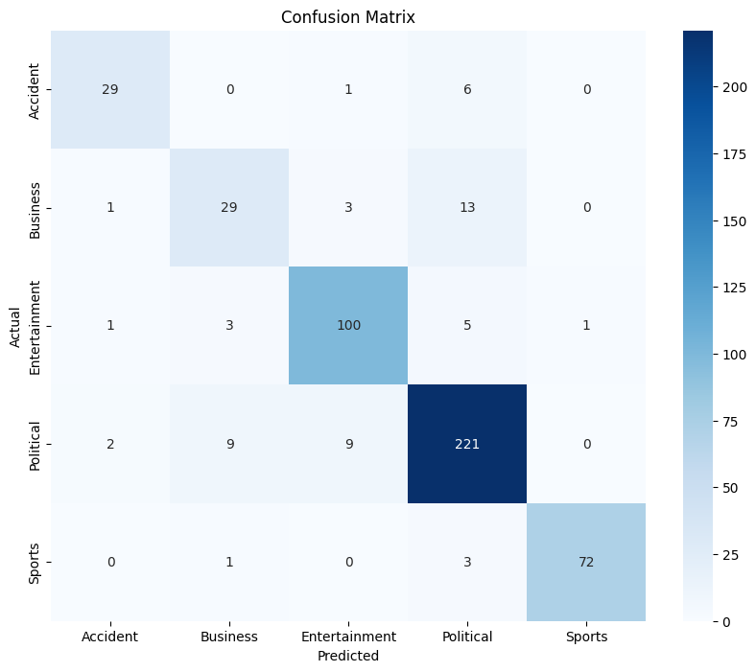
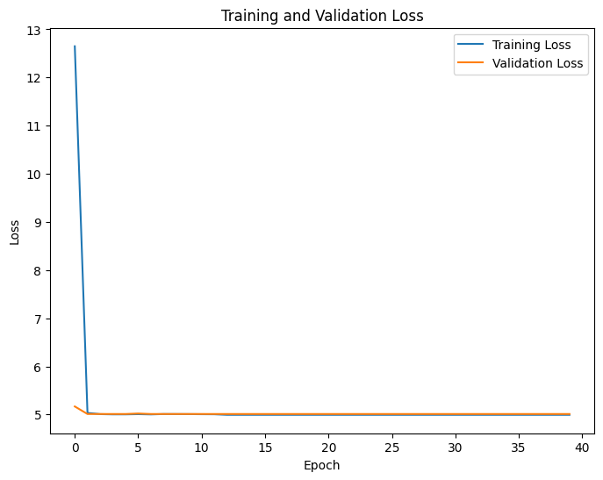
Results
Fig 3: Loss Graph of best result.
Fig 2: Confusion Matrix of best result.

Slide 11
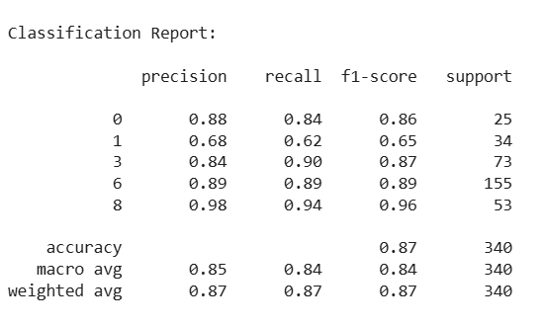
Results
Fig 4: Classification Report of best result.

Slide 12
CONCLUSION
This project aims to automate the categorization of Hindi news articles. We developed hybrid model pipeline i.e. HNVec integrated with HLM-CLS to automate the classification of Hindi news into 5 categories.
Our main aim is project is designed with a strong emphasis on practical implementation, ensuring its applicability in real-world scenarios.
This work supports faster, more accurate news categorization, aiding in efficient content management.

